Slide 1


The Color Red
Matt Hall
WDV151
02/10/2016

Slide 2

General Associations of Red
  Energy
  War
  Danger
  Strength
  Power
  Fall

Slide 3

Red Represents - Positive Connotations
Passion
Desire
Love
Special treatment (aka Red Carpet)
Red is a stimulating and attention grabbing color

Slide 4

Red Represents - Negative Connotations
Embarrassment
Anger
Debt
Red Tape

Slide 5

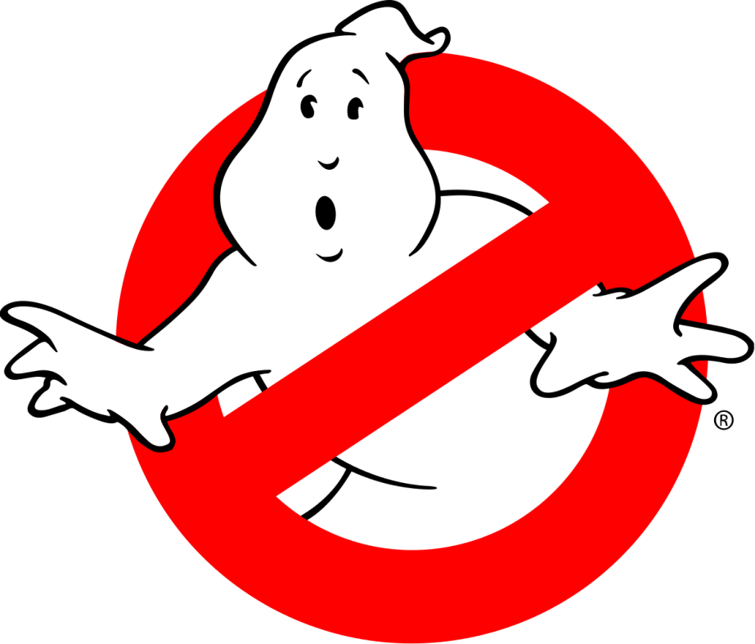
Meaning in US and Other Countries
Red means stop in the US (stop signs, stop lights, tail lights)
Red is the international color for stop
Red is also used in warnings and prohibitive signs.
For example a No Smoking sign or the classic Ghostbusters logo

Slide 6

Meaning in US and Other Countries
A red kimono symbolizes happiness/good luck in Japan
Brides in China, India, and Nepal all wear red
Approximately 77% of all flags include red

Slide 7

Meaning of Shades - Pink
Romance
Love
Friendship
Feminine qualities

Slide 8

Meaning of Shades - Burgundy
More sophisticated and serious
Less Energetic
Indicates controlled power
Often favored by the wealthy

Slide 9



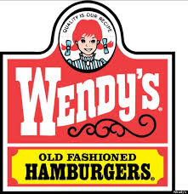


Red Logos

Slide 10
Sayings
Red Eye
  A late night flight (red eye flight)
Seeing red
  Angry / Out of control angry
Being in the red
  Owe money
Caught red handed
  Caught in the act
A Red Herring
  Misdirection
Not worth a red cent
  Worthless

